Slide 1
Concurrency:
Deadlock and Starvation
Lecturer: Li Yang
Contact: liyang23@swjtu.edu.cn
Office: X31506
QQ Group No.：733269440
Faculty: Computer and AI

Slide 2
Outline
Principles of Deadlock
Deadlock Prevention
Deadlock Avoidance
Deadlock Detection
Dining Philosophers Problem
Summary

Slide 3
6.1 Deadlock
Definition: The permanent（永久） blocking of a set of processes since competing for system resources or communicate with each other
Each process in the set is blocked awaiting an event that can only be triggered by another blocked process in the set
No efficient solution in general case

Slide 4
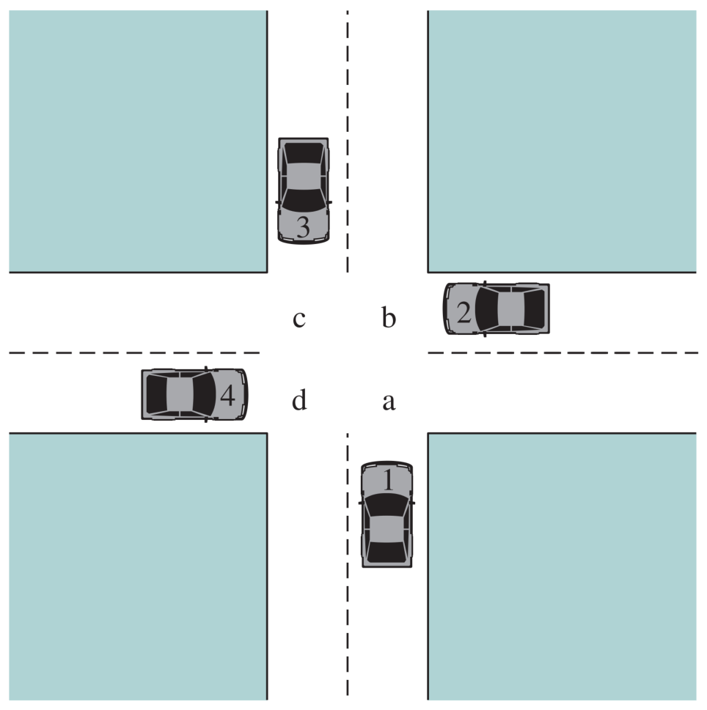
Potential Deadlock
The rule of the road in the United States is that a car at a four-way stop should defer to a car immediately to its right.
I need to cross c and d
I need to cross B and C
I need to cross d and a
I need to cross a and b

Slide 5
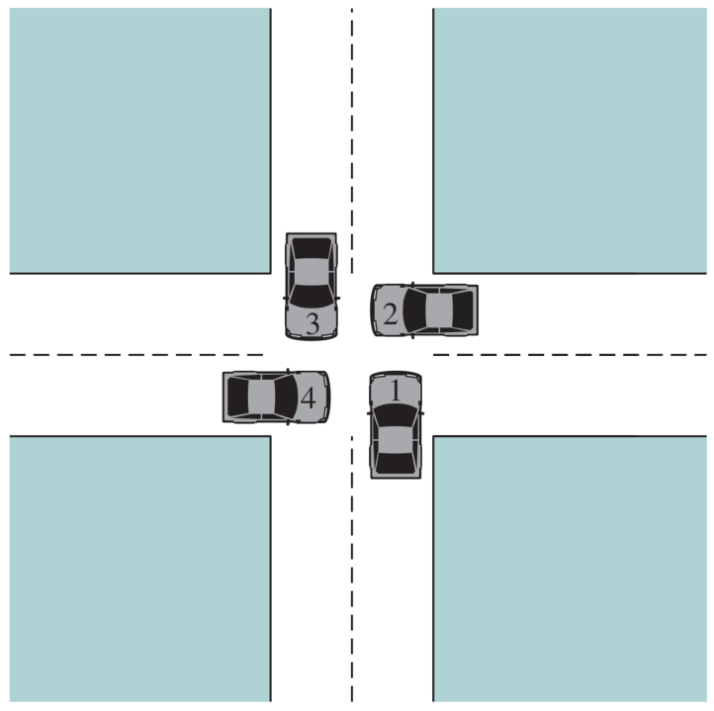
Actual Deadlock
Each car seizes one resource (one quadrant) but cannot proceed because the required second resource has already been seized by another car.
This is an actual deadlock.
HALT until d is free
HALT until c is free
HALT until a is free
HALT until b is free

Slide 6
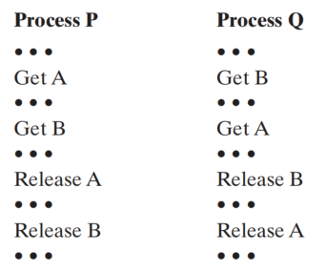
Deadlock Example
illustrates the progress of two processes competing for two resources

Slide 7
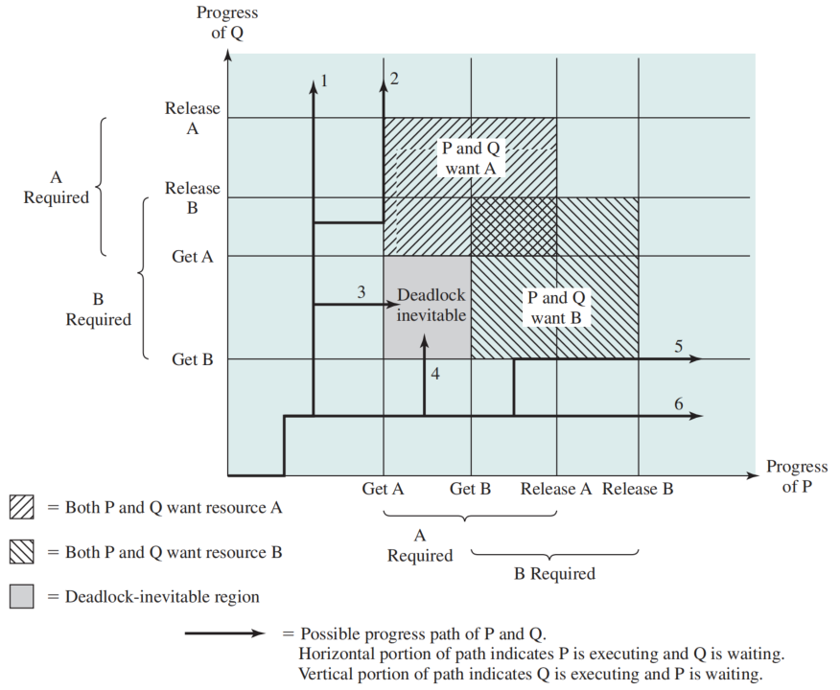
Joint Progress Diagram (联合进程图)

Slide 8
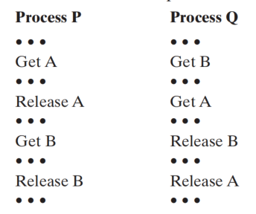
No Deadlock Example
Whether or not deadlock occurs depends on both the dynamics of the execution and on the details of the application.

Slide 9
Joint Progress Diagram (联合进程图)

Slide 10
Resource Categories
Reusable
  can be safely used by only one process at a time and is not deleted by that use
  processors, I/O channels, main and secondary memory, devices, files
Consumable
  one that can be created (produced) and destroyed (consumed)
  interrupts, signals, messages

Slide 11
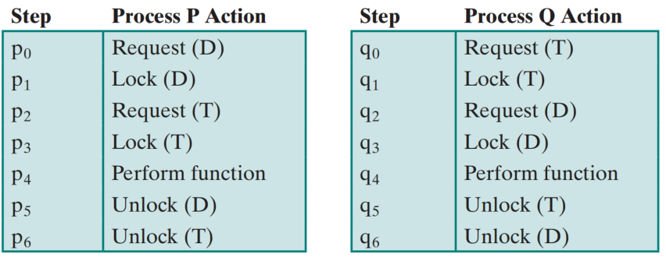
Example 1: reusable resource
a disk file D and a tape drive T
Two Processes Competing for Reusable Resources
While execute p0 p1 q0 q1 p2 q2，deadlock or not?

Slide 12
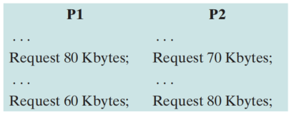
Example 2: Memory Request
Space is available for allocation of 200Kbytes, and the following sequence of events occur:
Deadlock or not? R1(p1), R1(p2), R2(p2), R2(p1)?

Slide 13
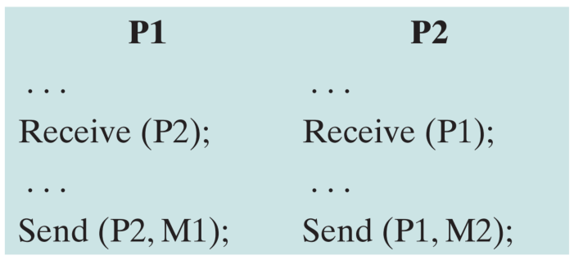
Consumable Resources Deadlock
Consider a pair of processes, in which each process attempts to receive a message from the other process and then send a message to the other process:
Deadlock occurs if the Receive is blocking

Slide 14
Resource Allocation Graphs
A useful tool in characterizing the allocation of resources to processes is the resource allocation graph
The resource allocation graph is a directed graph that depicts a state of the system of resources and processes, with each process and each resource represented by a node

Slide 15
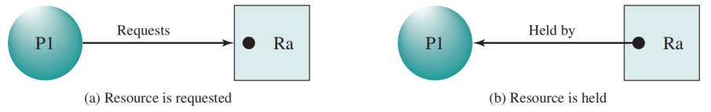
Resource Allocation Graphs

Slide 16
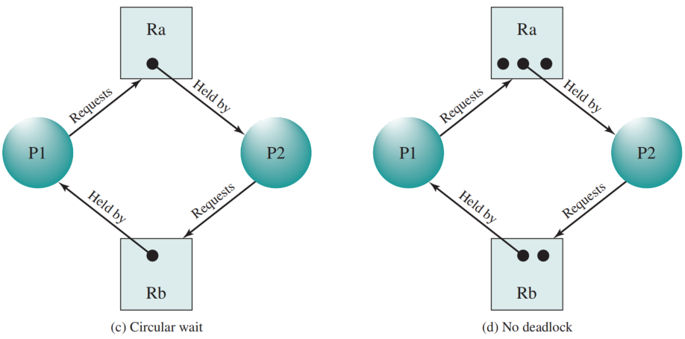
Resource Allocation Graphs

Slide 17
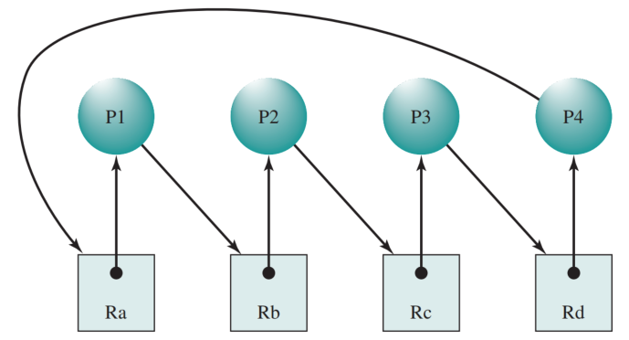
Resource Allocation Graphs
Circular wait (循环等待). A closed chain of processes exists, such that each process holds at least one resource needed by the next process in the chain
Resource Allocation Graph for Figure 6.1b

Slide 18
Conditions for Deadlock
Necessary Conditions （必要条件） for a deadlock:
Mutual Exclusion
  only one process may use a resource at a time
Hold and Wait
  a process may hold allocated resources while awaiting assignment of others
No Preemption
  no resource can be forcibly removed from a process holding it
Sufficient Condition (充分条件) for a deadlock:
Above three conditions, and
Circular Wait
  a closed chain of processes exists, such that each process holds at least one resource needed by the next process in the chain

Slide 19
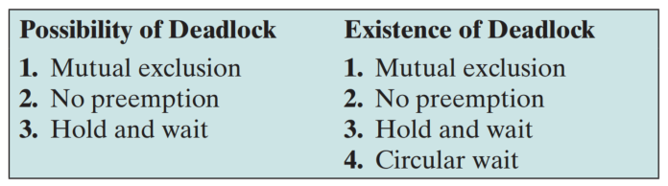
Conditions for Deadlock

Slide 20
Three Approaches Dealing with Deadlock
Deadlock prevention: Disallow one of the three necessary conditions for deadlock occurrence, or prevent circular wait condition from happening.
Deadlock avoidance: Do not grant a resource request if this allocation might lead to deadlock.
Deadlock detection: Grant resource requests when possible, but periodically check for the presence of deadlock and take action to recover.

Slide 21
6.2 Deadlock Prevention
Mutual Exclusion
  In general, the first of the four listed conditions cannot be disallowed.
Hold and Wait
  require that a process request all of its required resources at one time and blocking the process until all requests can be granted simultaneously
  Inefficient: a long time waiting and some resource may be unused during the allocation

Slide 22
6.2 Deadlock Prevention
No Preemption
  if a process holding certain resources is denied a further request, that process must release its original resources and request them again
  if a process requests a resource that is currently held by another process, OS may preempt the second process and require it to release its resources
Circular Wait
  define a linear ordering of resource types. If a process has been allocated resources of type R, then it may subsequently request only those resources of types following R in the ordering.

Slide 23
6.3 Deadlock Avoidance
Deadlock prevent leads to inefficient use of resource and inefficient execution of processes.
Deadlock avoidance: allows the three necessary conditions but makes judicious choices to assure that the deadlock point is never reached.
As such, avoidance allows more concurrency than prevention.
Requires knowledge of future process requests

Slide 24
Two Approaches to Deadlock Avoidance
Process Initiation Denial
  do not start a process if its demands might lead to deadlock
Resource Allocation Denial （the banker algorithm）
  do not grant an incremental resource request to a process if this allocation might lead to deadlock

Slide 25
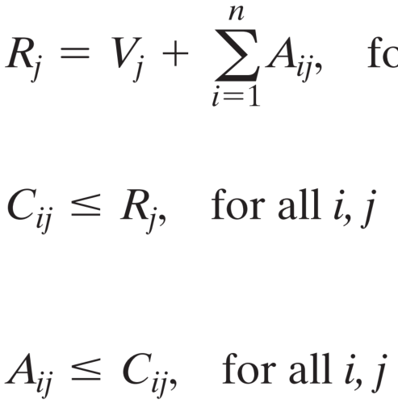
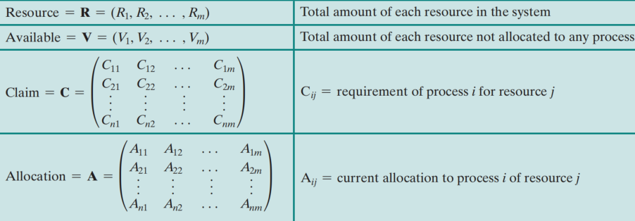
Key Element Definitions
All resources are either available or allocated.
No process can claim more than the total amount of resources in the system.
No process is allocated more resources of any type than the process originally claimed to need.

Slide 26
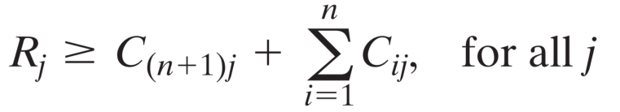
Process Initiation Denial （进程启动拒绝）
The following relationships hold when starting a new process

Slide 27
Resource Allocation Denial （资源分配拒绝）
the banker algorithm
do not grant an incremental resource request to a process if this allocation might lead to deadlock
State of the system reflects the current allocation of resources to processes
Safe state is one in which there is at least one sequence of resource allocations to processes that does not result in a deadlock
Unsafe state is a state that all execution sequences will result in deadlock

Slide 28
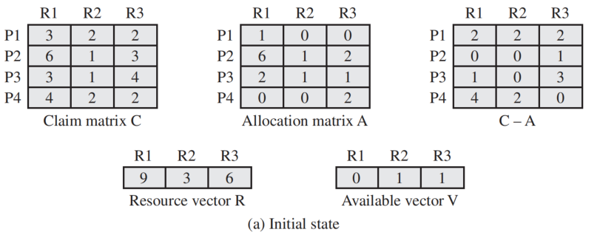
Determination of a Safe State
State of a system consisting of four processes and three resources

Slide 29
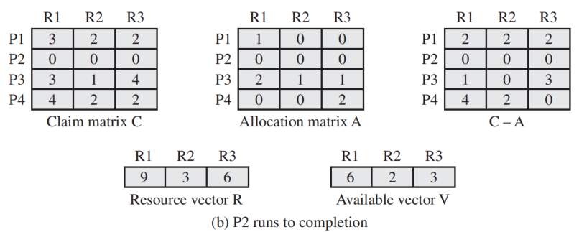
P2 Runs to Completion

Slide 30
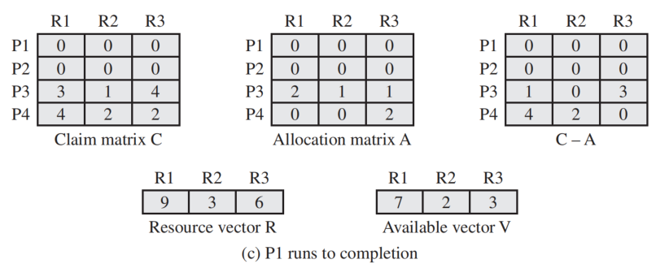
P1 Runs to Completion

Slide 31
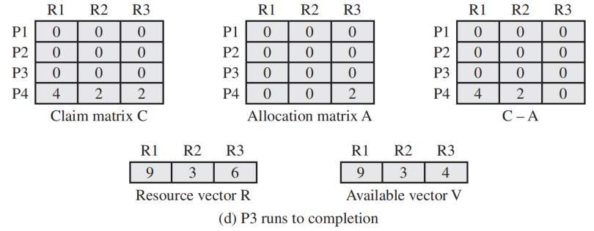
P3 Runs to Completion
Thus, the state defined originally is a safe state. The sequence is P2, P1,P3,P4

Slide 32
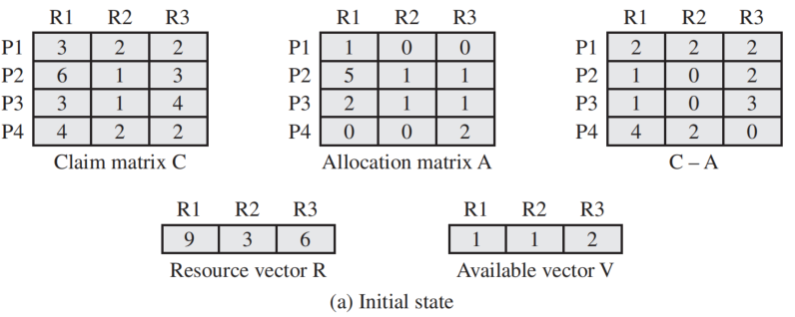
Determination of an Unsafe State

Slide 33
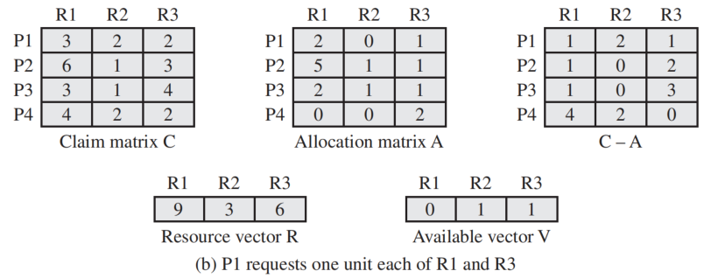
Determination of an Unsafe State
It is a unsafe state.

Slide 34
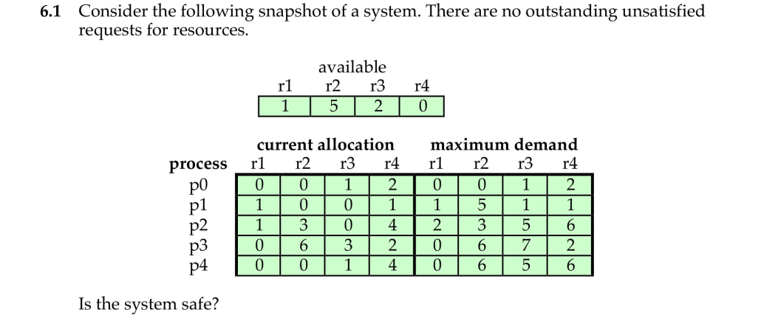
Quiz

Slide 35
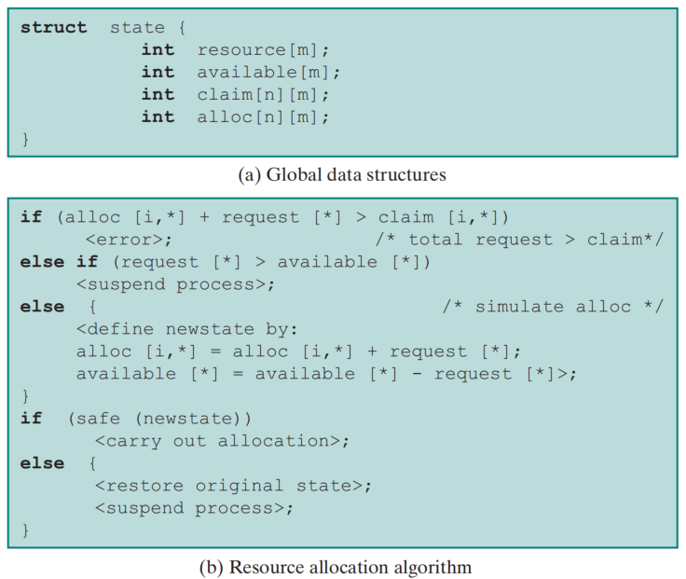
Deadlock Avoidance Logic

Slide 36
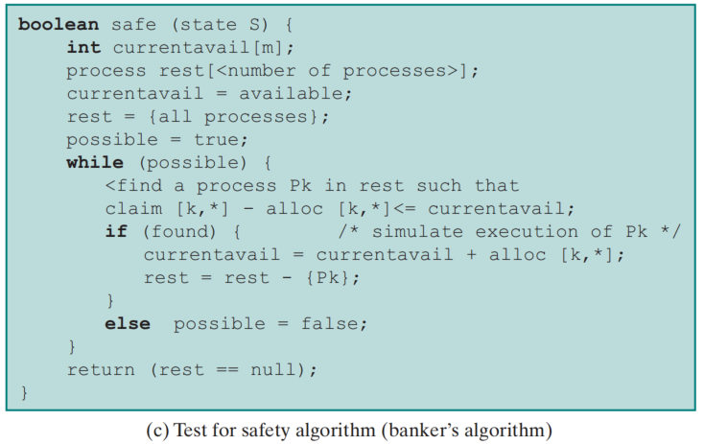
Deadlock Avoidance Logic

Slide 37
Deadlock Avoidance Advantages
Advantages
  It is not necessary to preempt and rollback processes, as in deadlock prevention
  It is less restrictive than deadlock prevention
Restrictions
  Maximum resource requirement for each process must be stated in advance
  Processes under consideration must be independent and with no synchronization requirements
  There must be a fixed number of resources to allocate
  No process may exit while holding resources

Slide 38
6.4 Deadlock Detection
Deadlock prevention strategies are very conservative （保守）
  limit access to resources by imposing restrictions on processes
Deadlock detection strategies do the opposite
  resource requests are granted whenever possible
A check for deadlock can be made as frequently as each resource request or, less frequently, depending on how likely it is for a deadlock to occur.

Slide 39
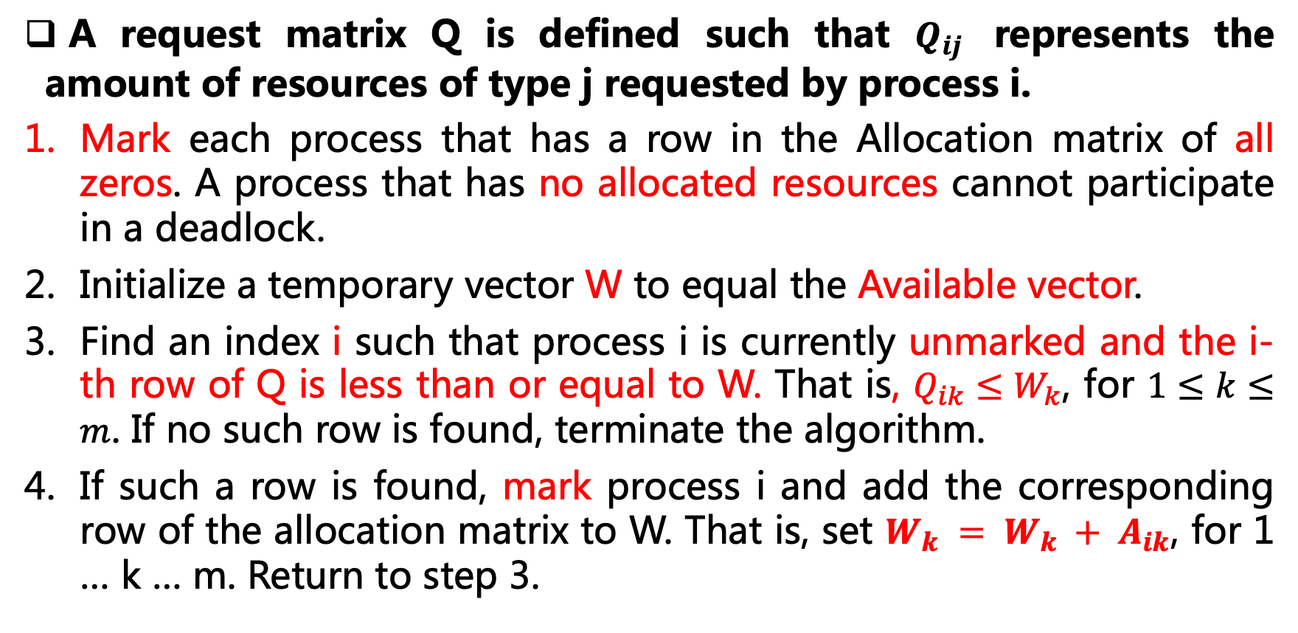
Deadlock Detection Strategy
A request matrix Q is defined such that $Q_{ij}$ represents the amount of resources of type j requested by process i.
Mark each process that has a row in the Allocation matrix of all zeros. A process that has no allocated resources cannot participate in a deadlock.
Initialize a temporary vector W to equal the Available vector.
Find an index i such that process i is currently unmarked and the i-th row of Q is less than or equal to W. That is, $Q_{ik}≤W_{k}$, for $1≤k≤m$. If no such row is found, terminate the algorithm.
If such a row is found, mark process i and add the corresponding row of the allocation matrix to W. That is, set $W_{k} = W_{k} + A_{ik}$, for 1 … k … m. Return to step 3.
A deadlock exists if and only if there are unmarked processes at the end of the algorithm

Slide 40
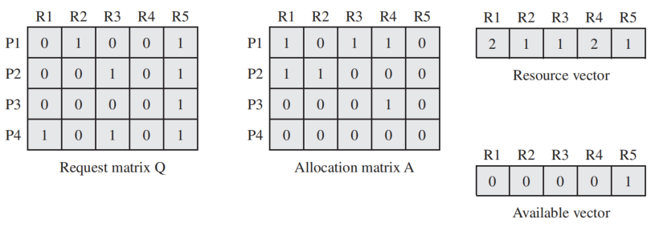
Examples of Deadlock Detection
P4, P3 are marked, then terminated.
P1, P2 are unmarked.

Slide 41
Recovery Strategies
Abort all deadlocked processes （applied by most of OS）
Back up each deadlocked process to some previously defined checkpoint and restart all processes
Successively abort deadlocked processes until deadlock no longer exists
Successively preempt resources until deadlock no longer exists

Slide 42
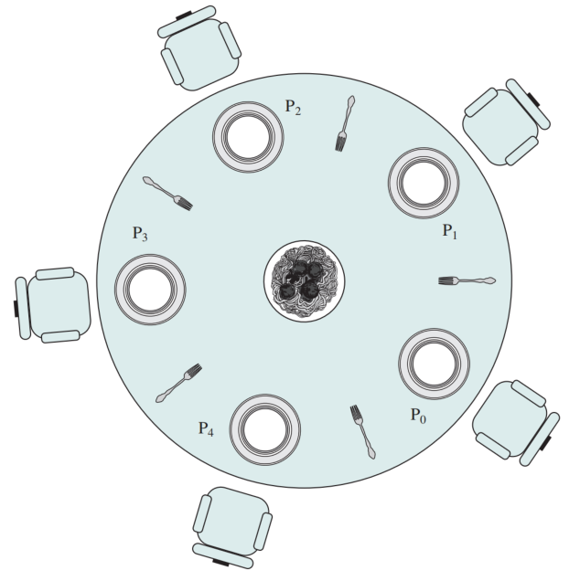
Dining Philosophers Problem
Devise a algorithm that allow the philosophers to eat
  No two philosophers can use the same fork at the same time (mutual exclusion)
  Avoid deadlock and starvation
using the two forks on either side of the plate, takes and eats some spaghetti

Slide 43
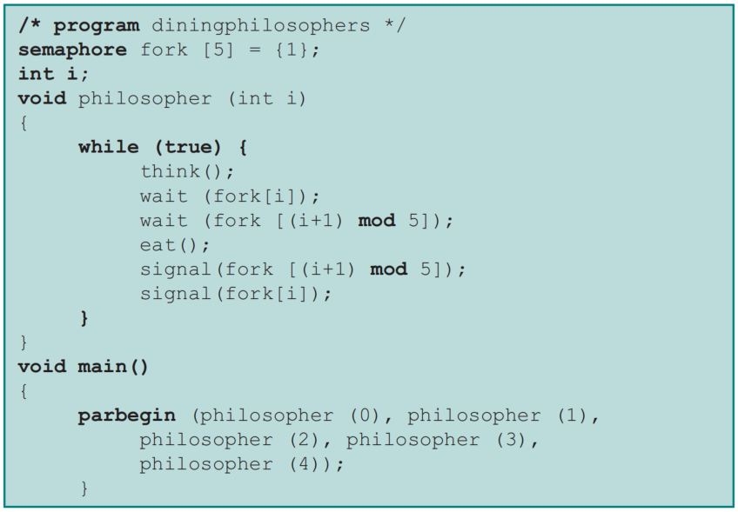
Solution Using Semaphores
Each philosopher first picks up the fork on the left then the fork on the right.

Slide 44
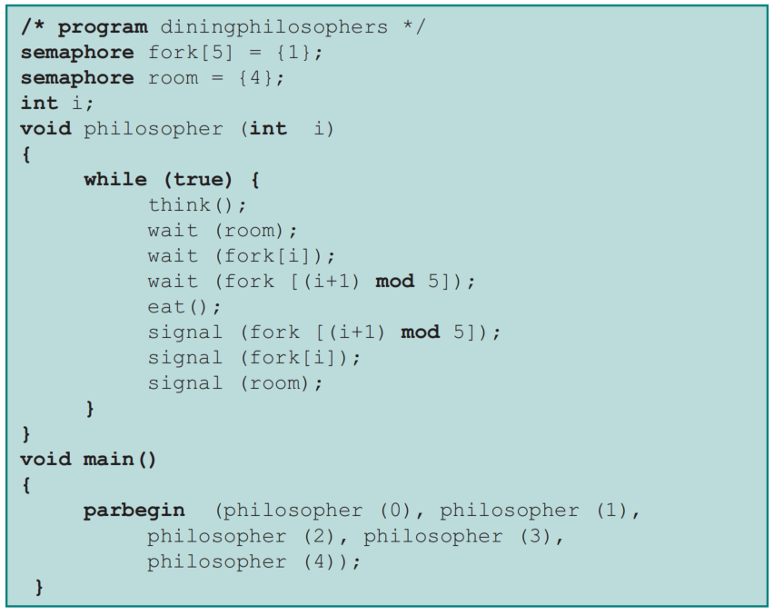
A Second Solution . . .
consider adding an attendant who only allows four philosophers at a time into the dining room.

Slide 45
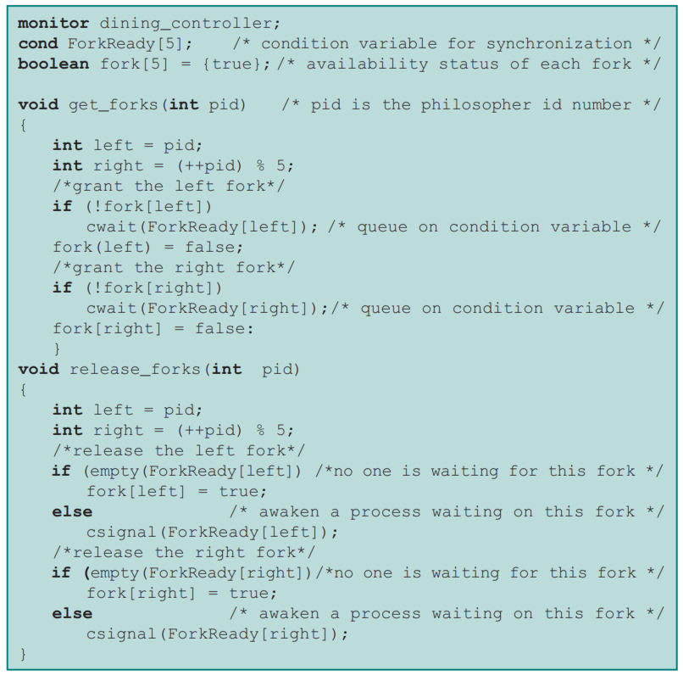
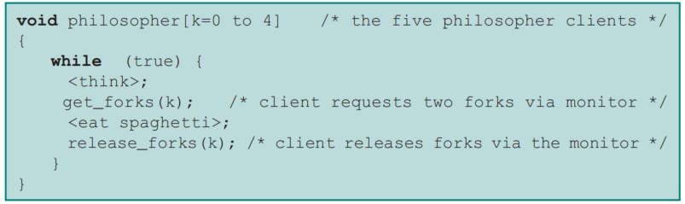
Solution Using A Monitor
Will deadlock happen using monitor？
How many philosopher can eat together?

Slide 46
Summary
Deadlock:
  the blocking of a set of processes that either compete for system resources or communicate with each other
  blockage is permanent unless OS takes action
  may involve reusable or consumable resources
Dealing with deadlock:
  prevention – guarantees that deadlock will not occur
  avoidance – analyzes each new resource request (Banker algorithm)
  detection – OS checks for deadlock and takes action (recovery)

Slide 47
Quiz
Given the following state of a system:
The system comprises of five processes and four resources.
P1–P5 denotes the set of processes.
R1–R4 denotes the set of resources.
Total Existing Resources:

Slide 48
Quiz
Snapshot at the initial time stage:
a. Compute the Available vector.
b. Compute the Need Matrix.
c. Is the current allocation state safe? If so, give a safe sequence of the process. In addition, show how the Available (working array) changes as each process terminates.
d. If the request (1, 1, 0, 0) from P1 arrives, will it be correct to grant the request?Justify your decision.

Slide 49
Quiz

